Slide 2
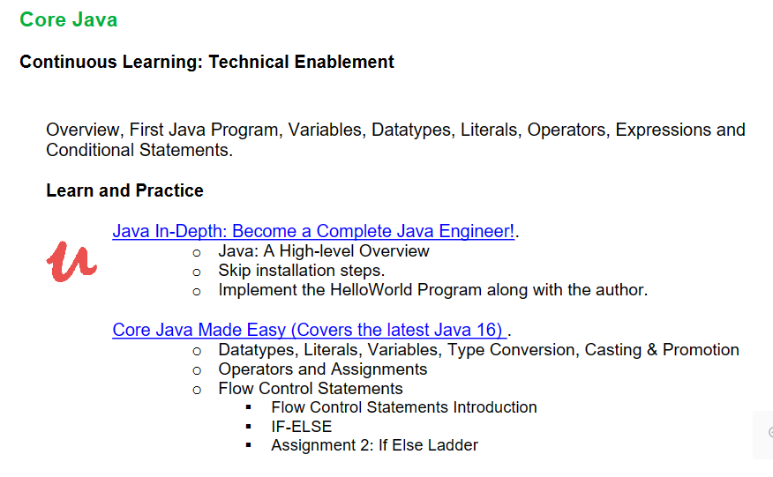

Slide 3
What is Java?
Java is a class-based, high-level and object-oriented programming language for building web and desktop applications.
JAVA was developed by Sun Microsystems Inc in 1991, later acquired by Oracle Corporation.
It was developed by James Gosling , Mike Sheridan and Patrick Naughton.

Slide 4
It follows the principle of WORA (Write Once Run Anywhere) – you can run a java program as many times as you want on a Java supported platform after it is compiled.
There is no need for recompilation.
A platform is any hardware or software environment where you can run your programs.
Java is known as a platform because it has a runtime environment (JRE) and API.

Slide 5
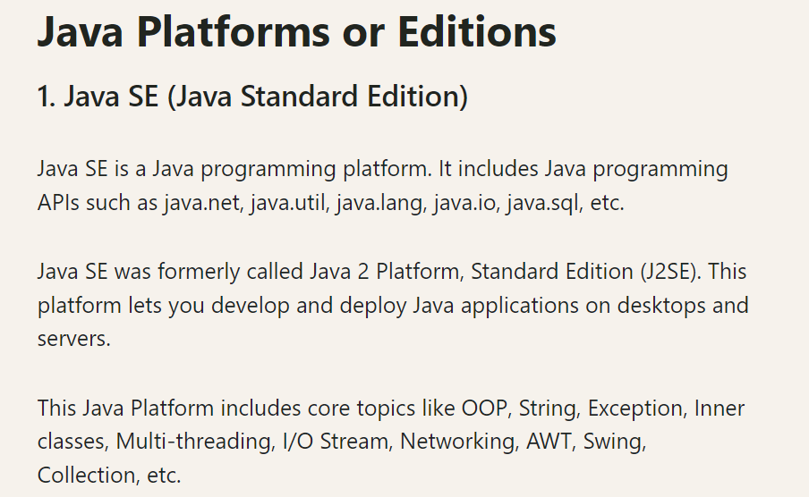

Slide 6
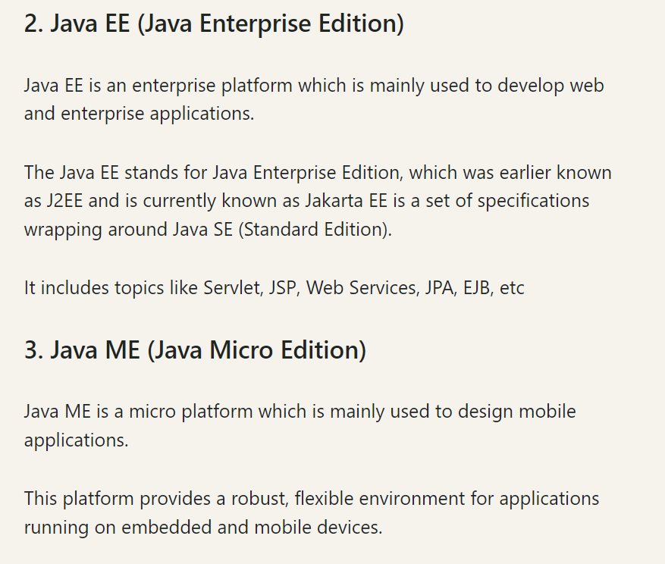

Slide 7
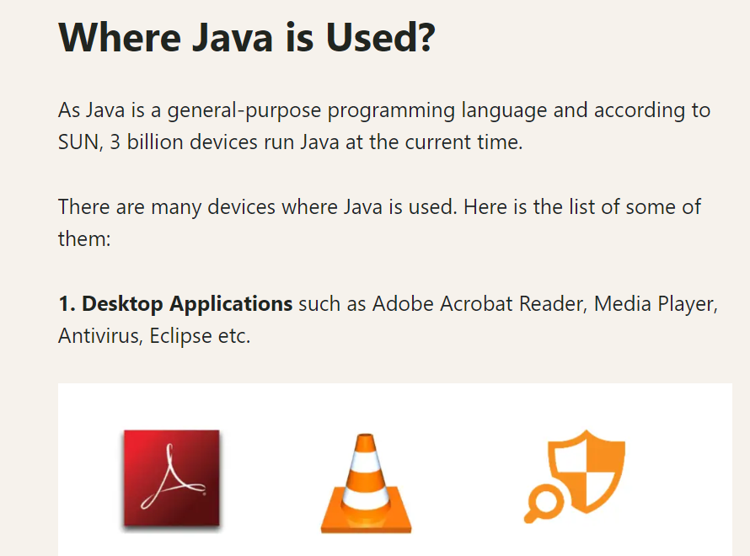

Slide 8
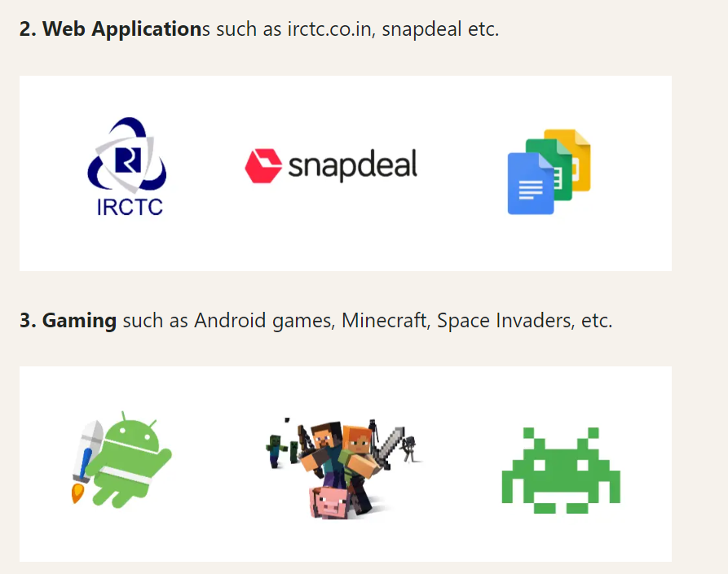

Slide 9
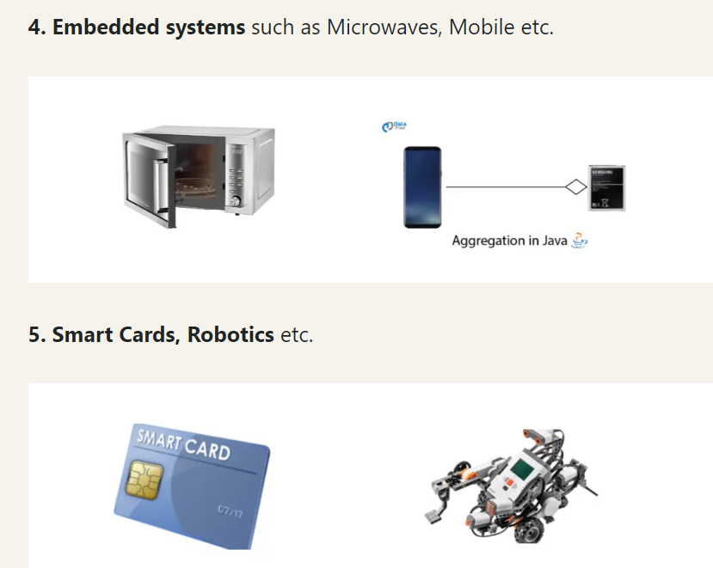

Slide 10
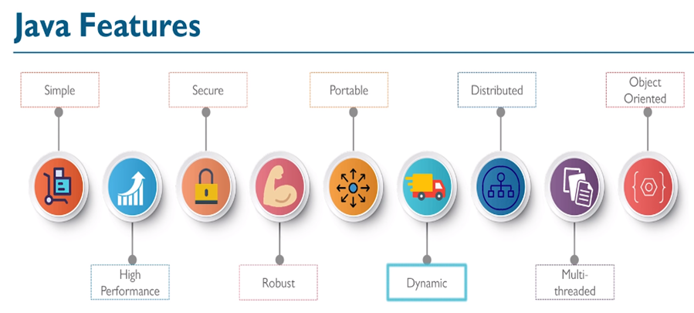

Slide 11
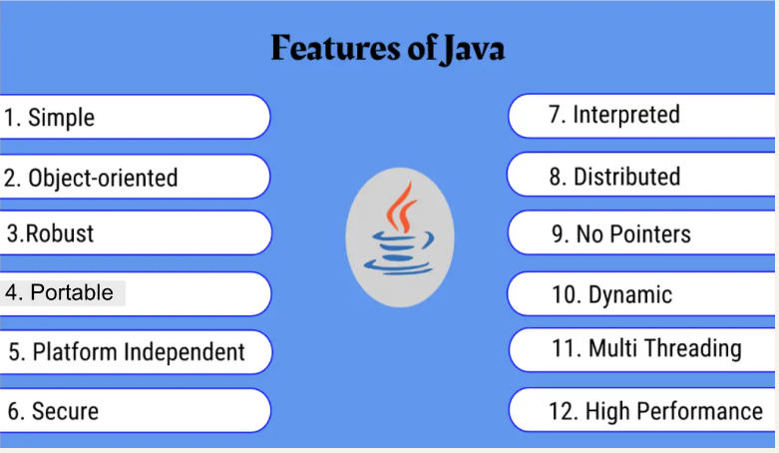

Slide 12
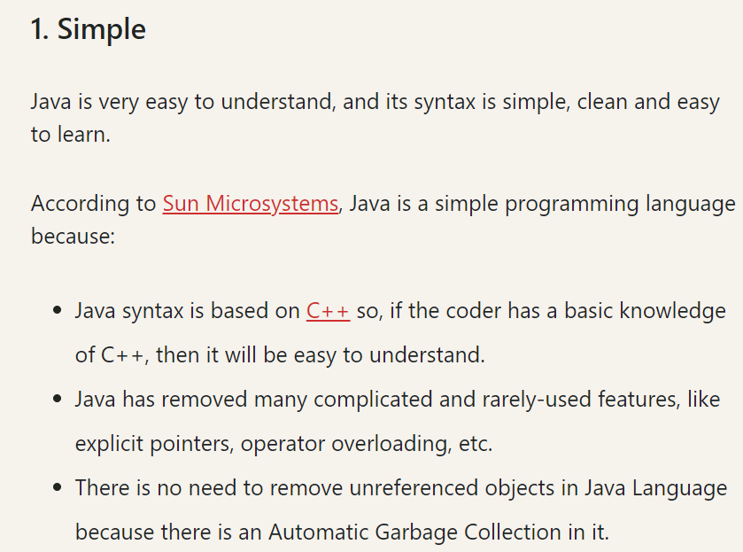

Slide 13
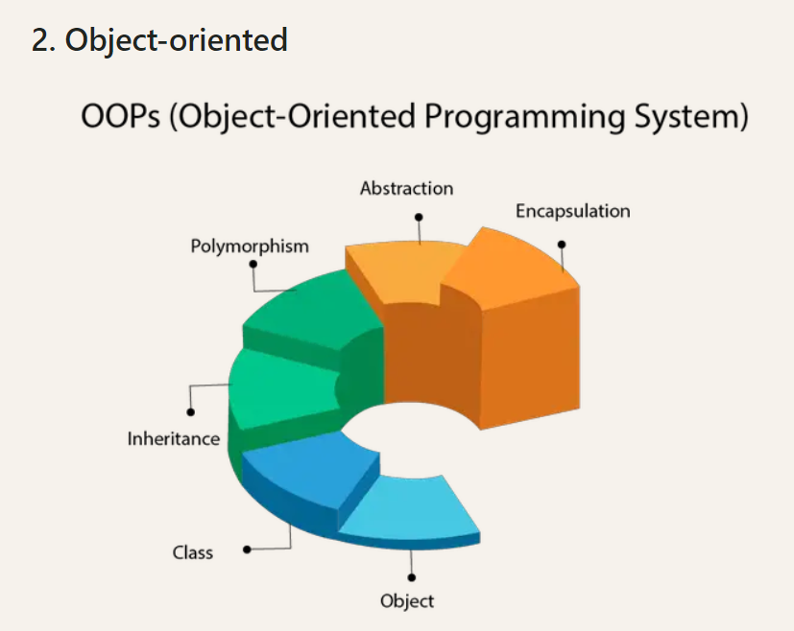

Slide 14
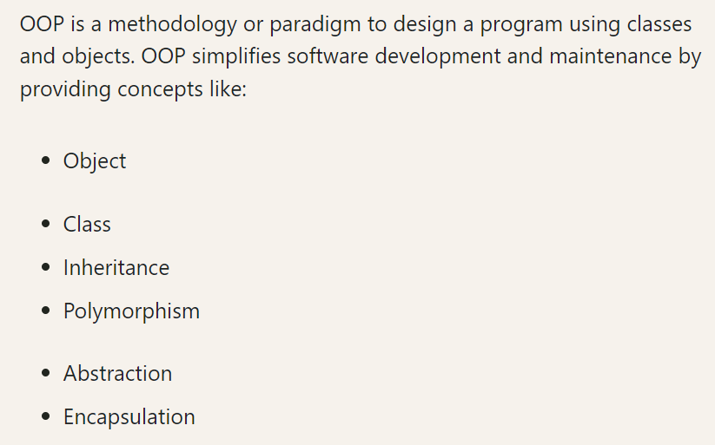

Slide 15
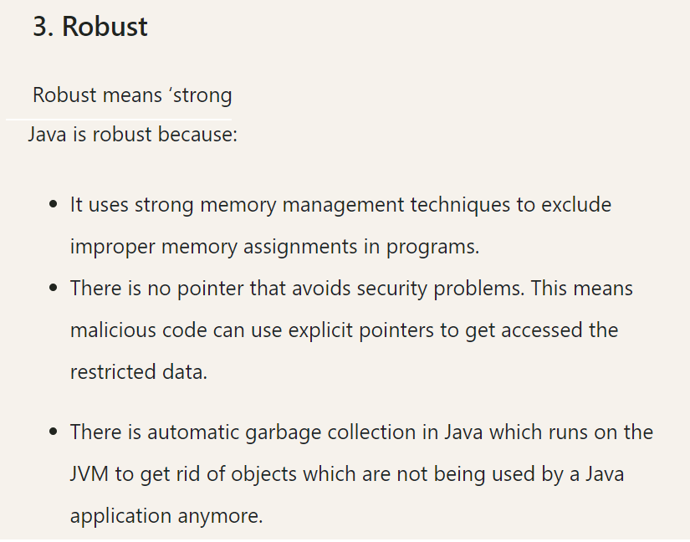

Slide 16
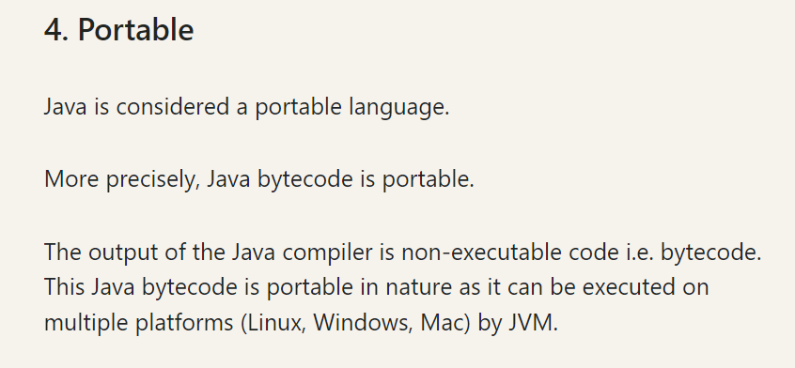

Slide 17
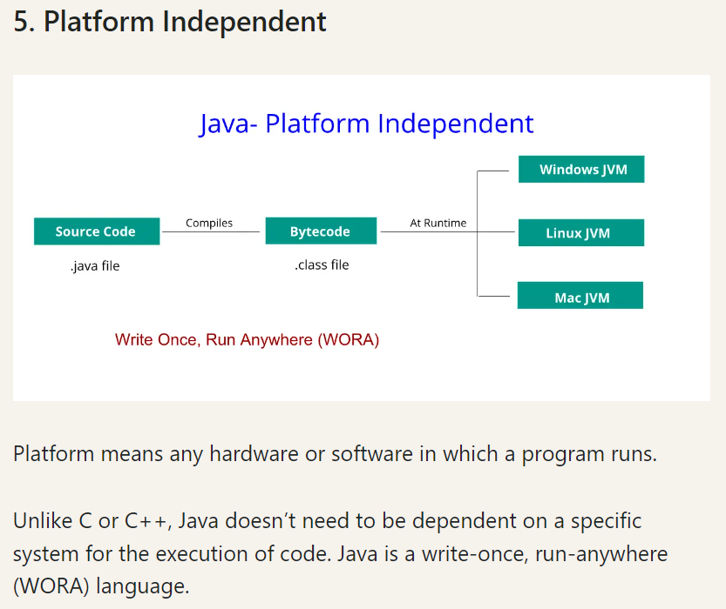

Slide 18
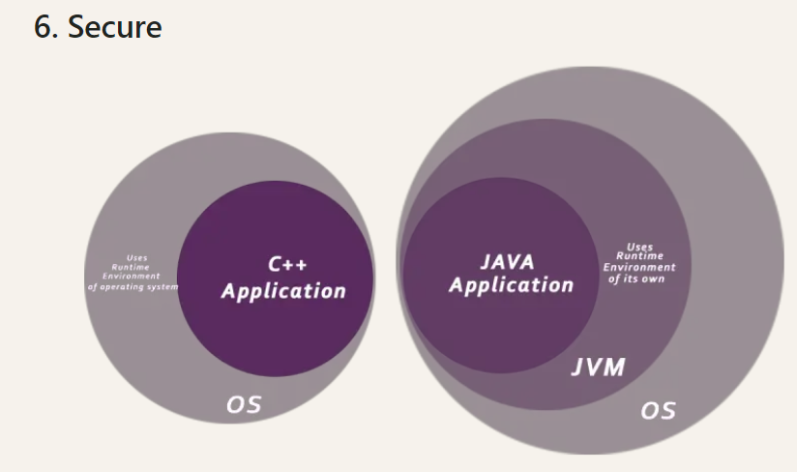

Slide 19
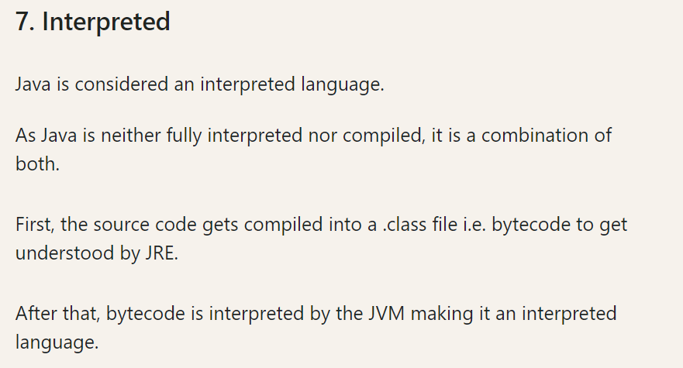

Slide 20
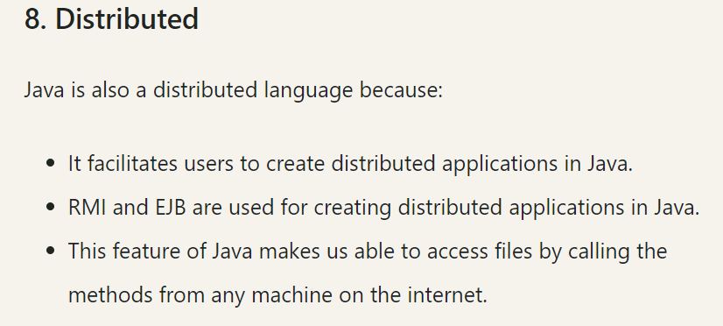

Slide 21
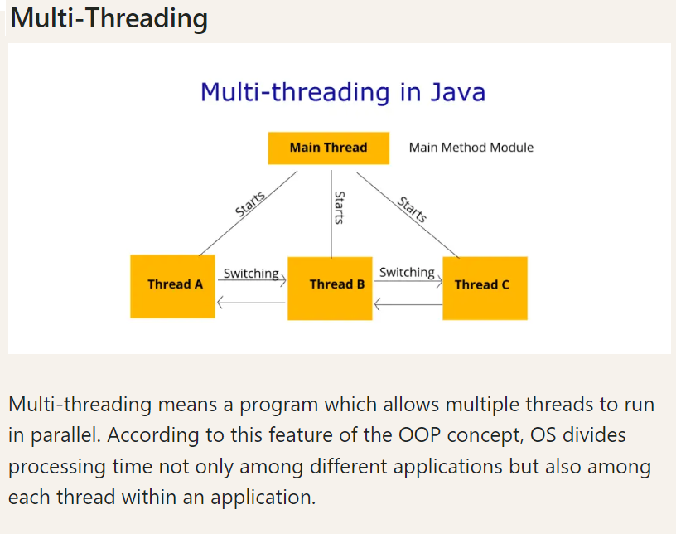

Slide 23
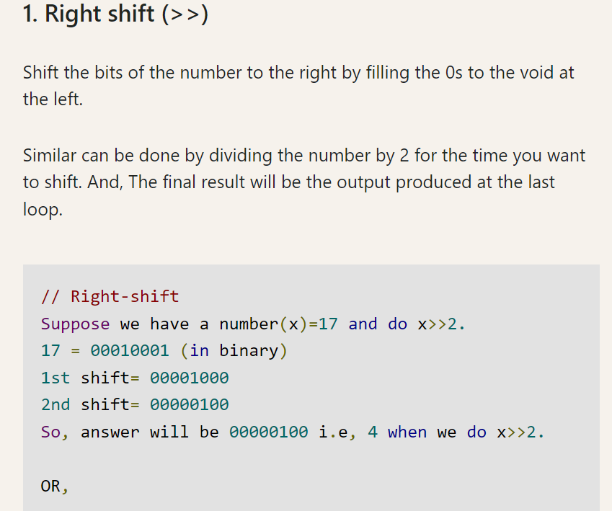

Slide 24
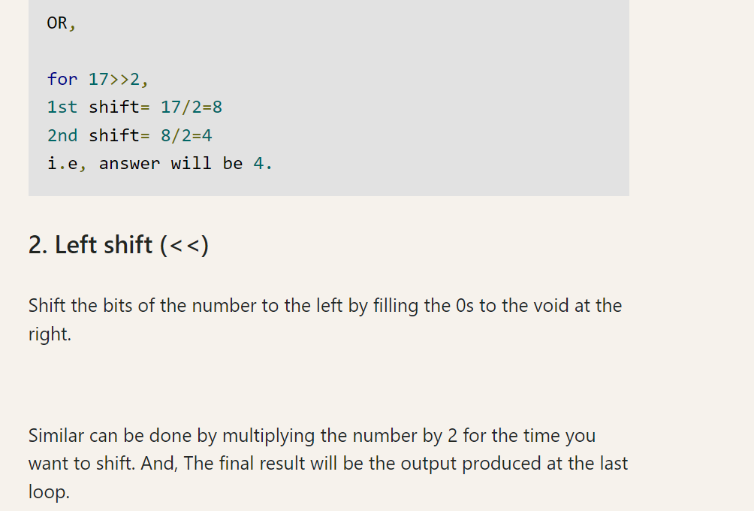

Slide 25
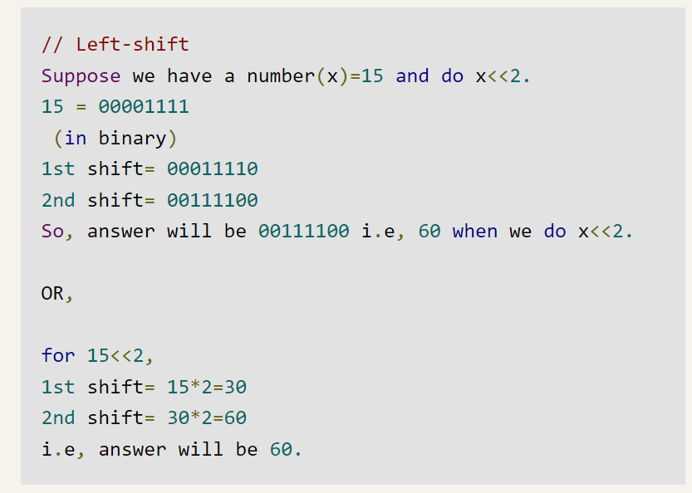

Slide 26
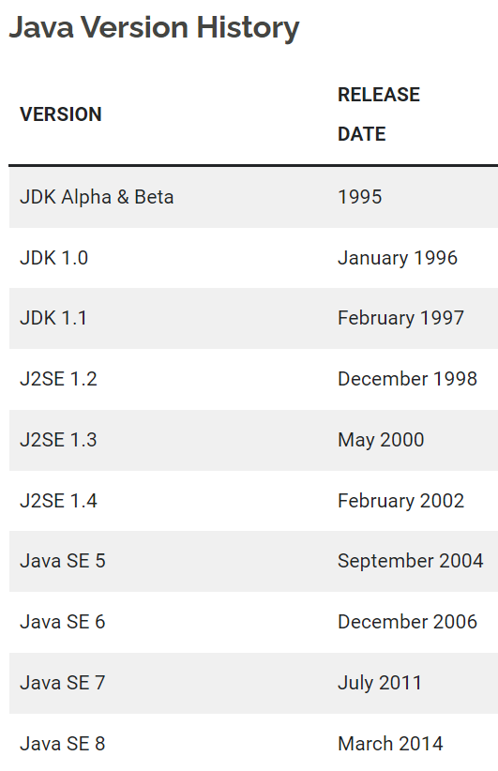

Slide 27
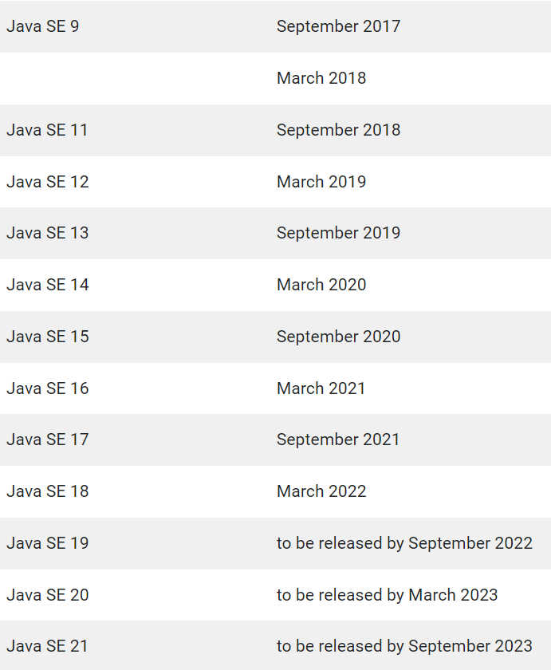

Slide 28
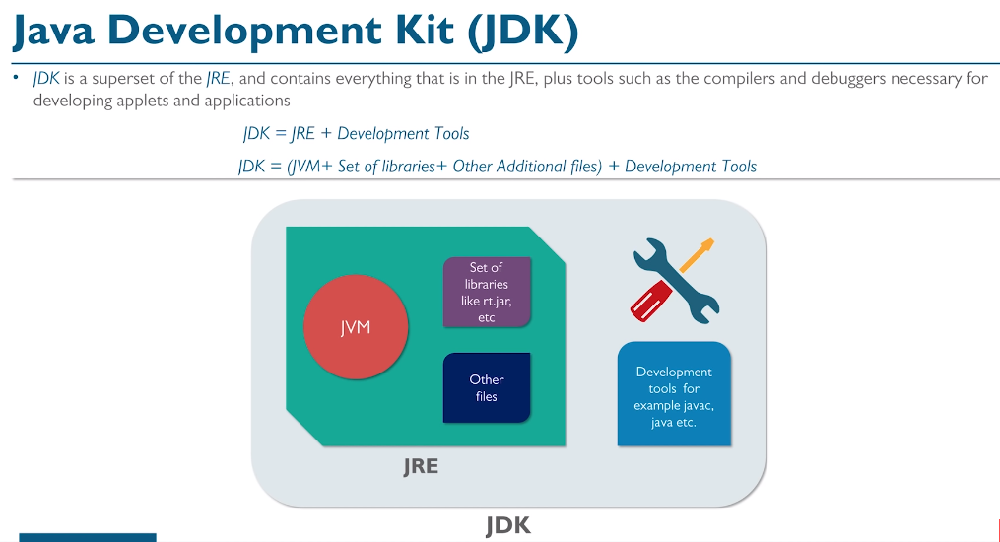

Slide 29
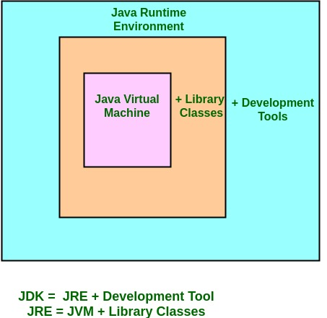
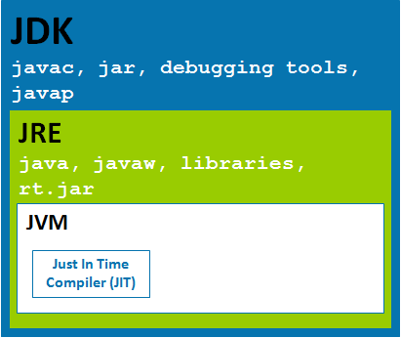

Slide 30
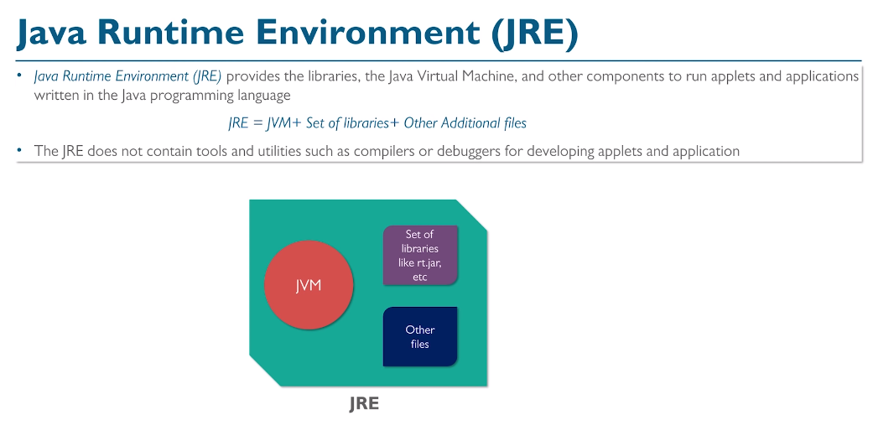

Slide 31
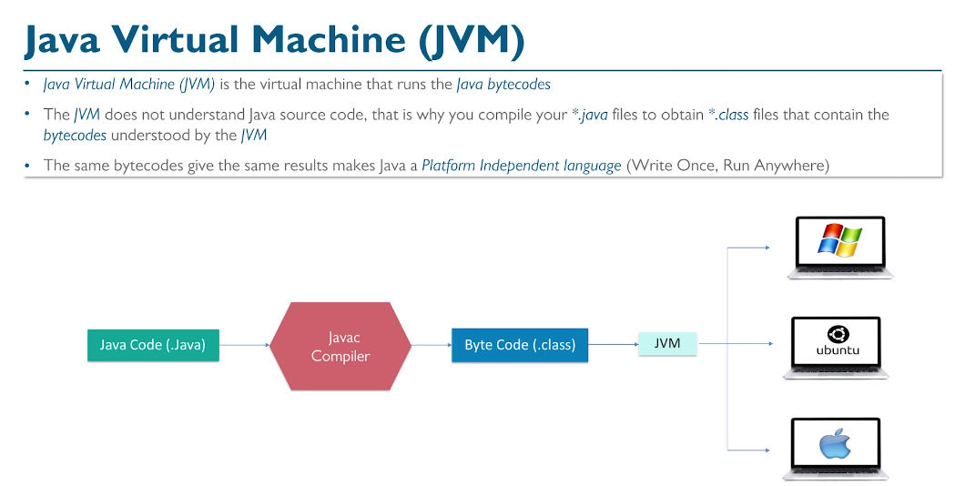

Slide 32
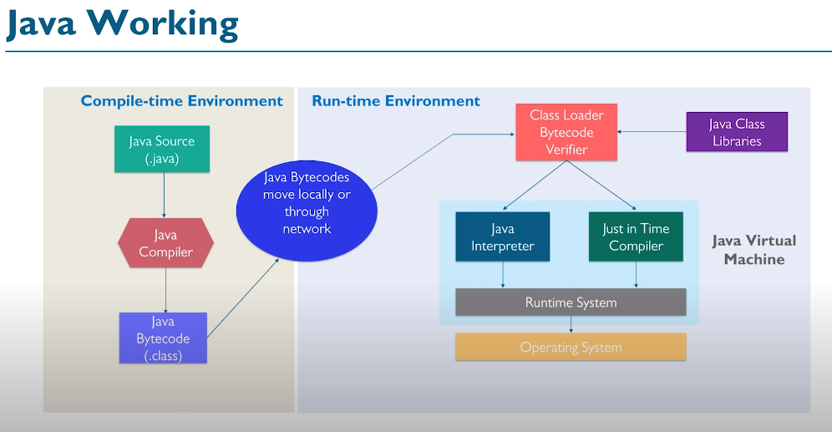

Slide 33
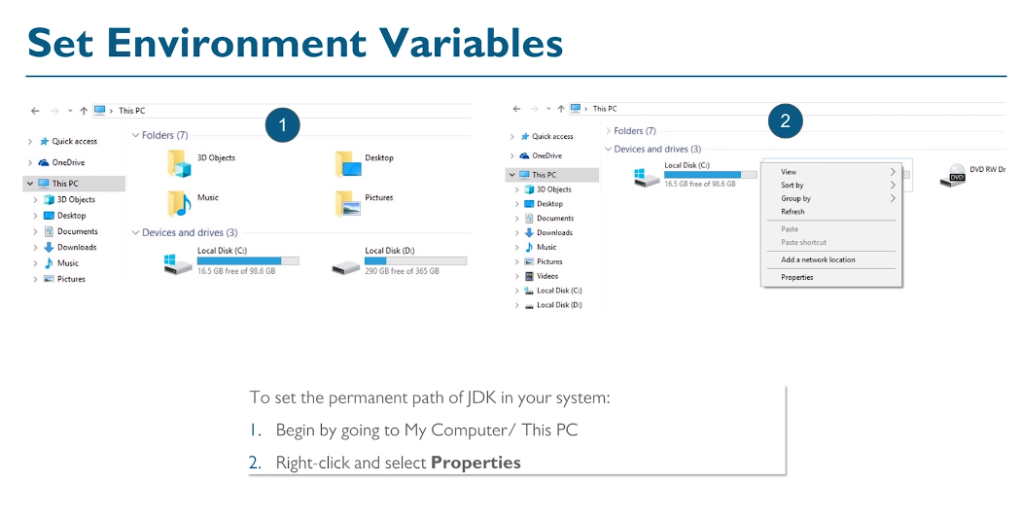

Slide 34
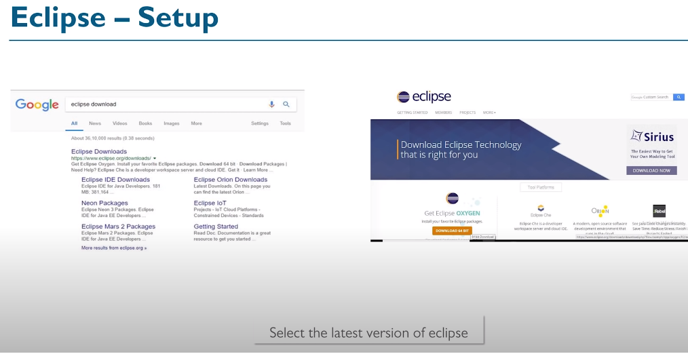

Slide 35
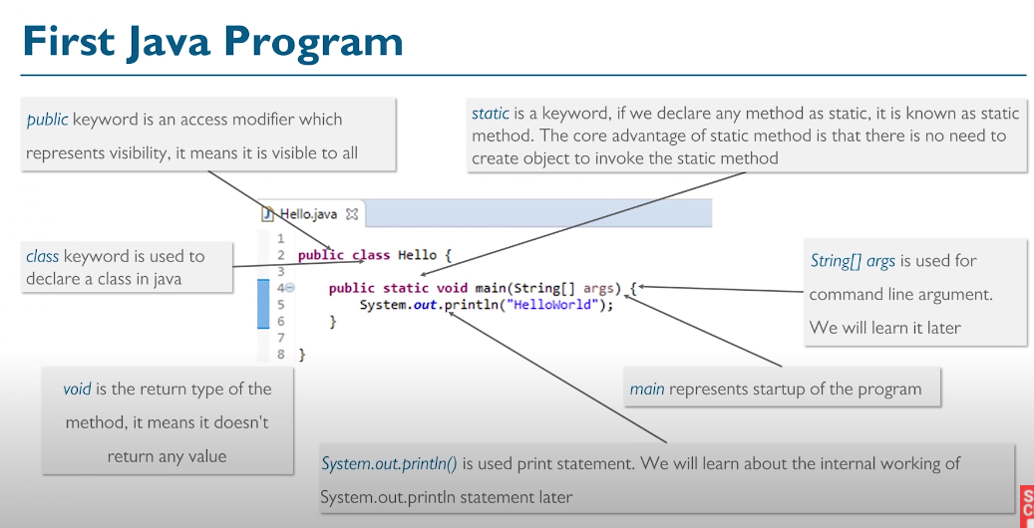

Slide 36
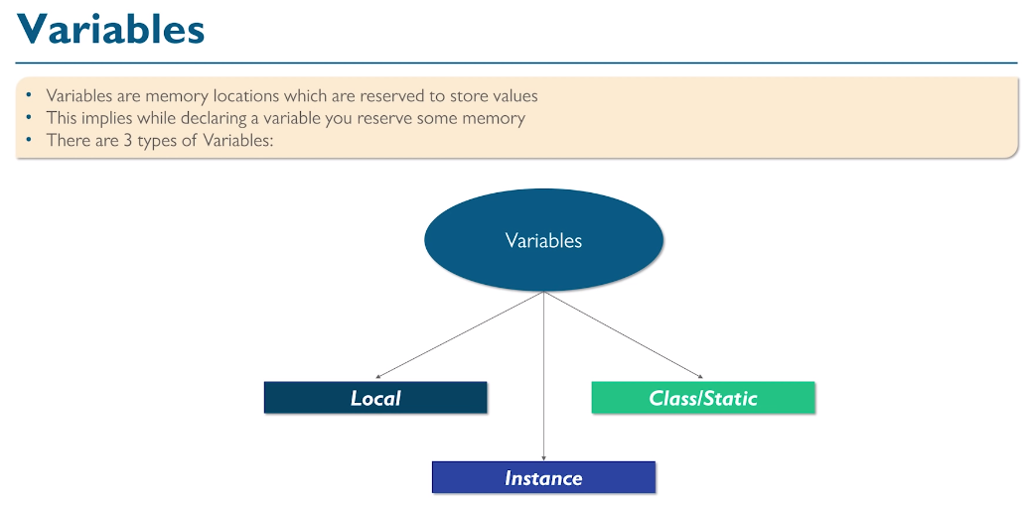

Slide 37
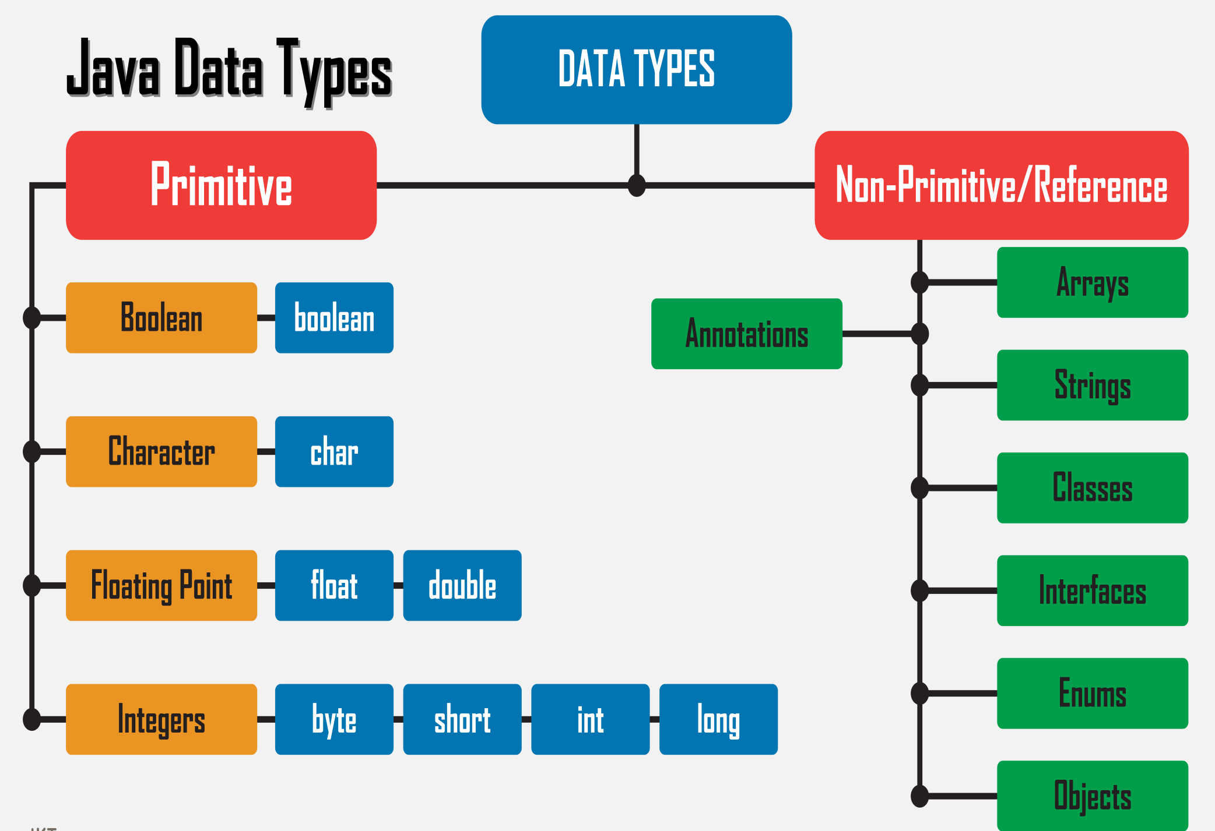

Slide 38
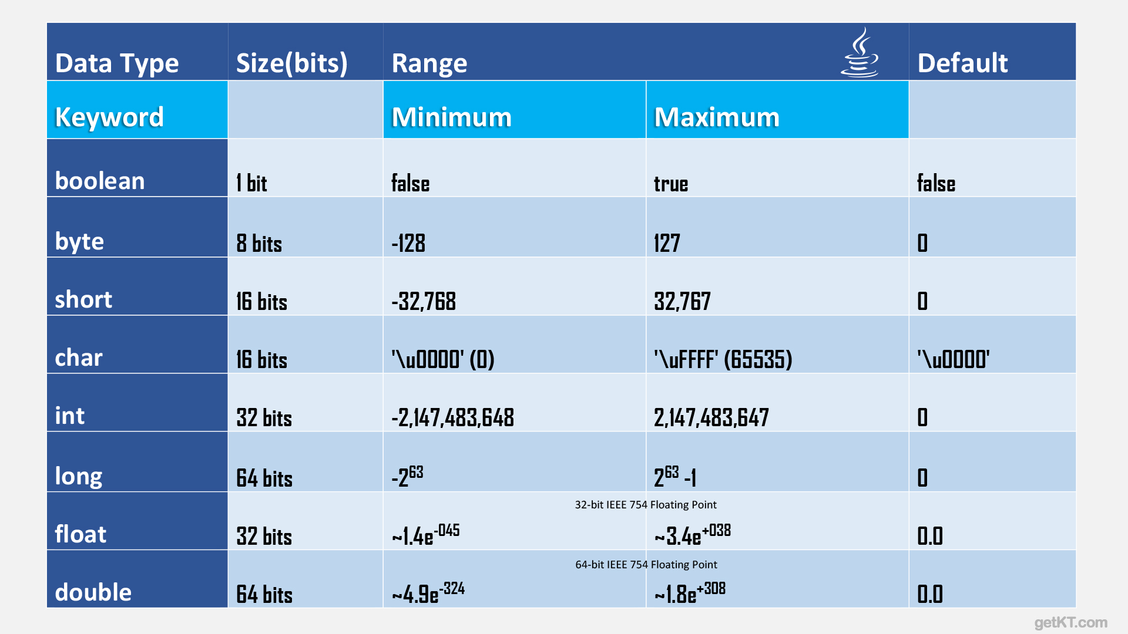

Slide 39
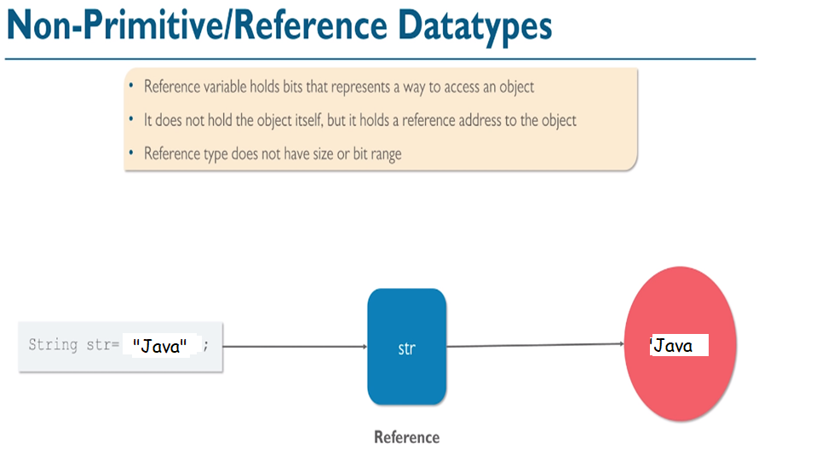

Slide 40
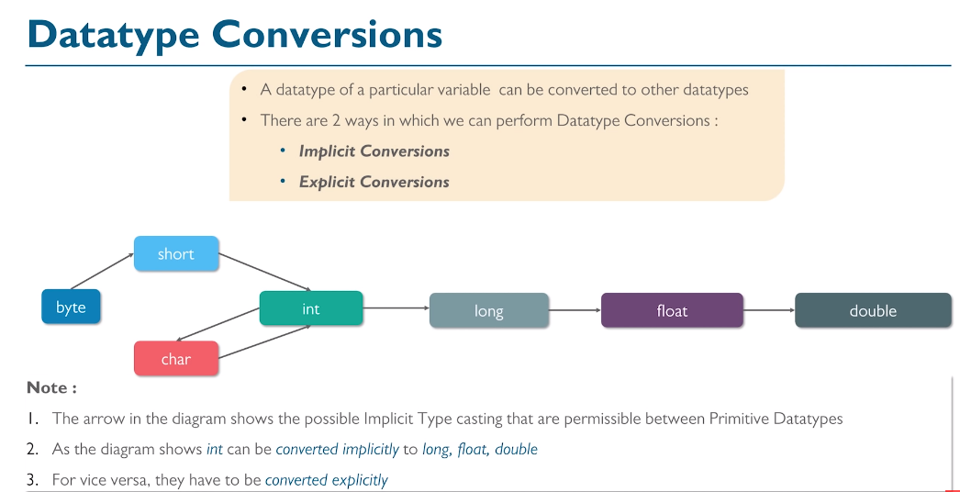

Slide 41
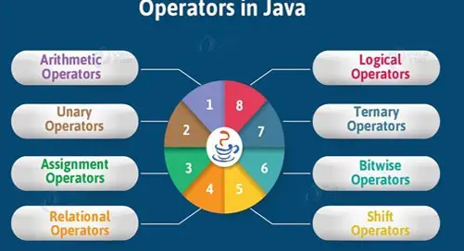

Slide 42
There as many types of Operators in Java as follows:
Arithmetic Operator (+ -- * / %)
Assignment Operator ( = )
Relational Operator ( > < >= <= == != )
Logical Operator (&& || ! )
Bitwise Operator ( & | ^ ~ )
Unary Operator (++ - - )
Shift Operator (<< >> )
Ternary Operator (condition) ? True-statements : false-statements

Slide 43
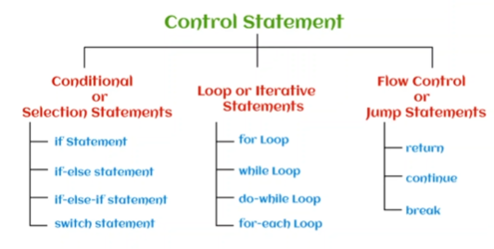

Slide 44
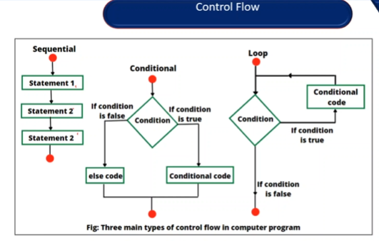

Slide 45
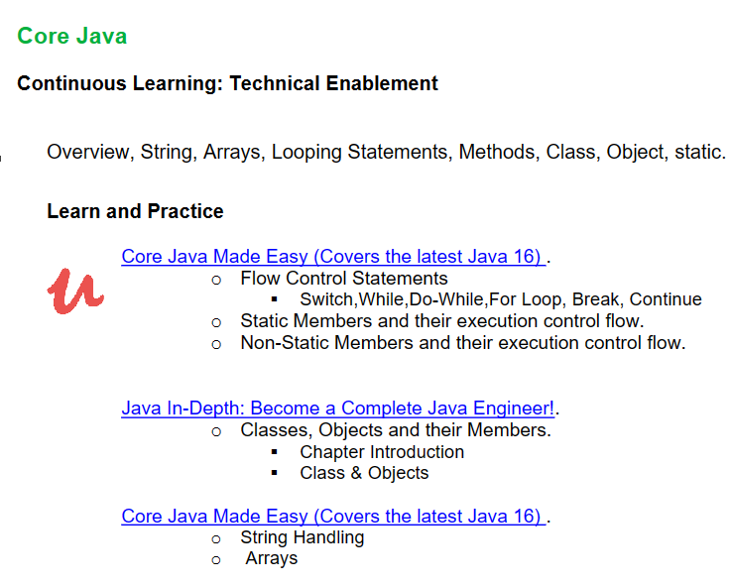

Slide 46
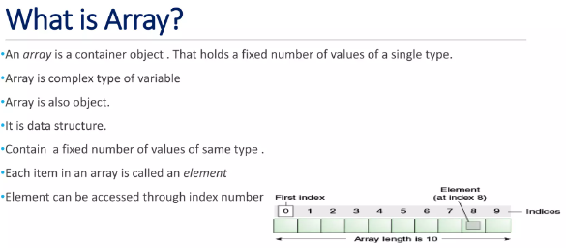

Slide 47
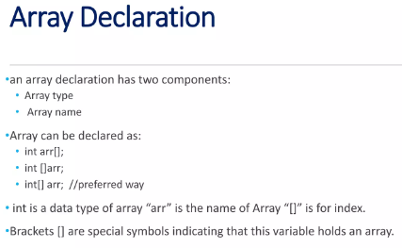

Slide 48
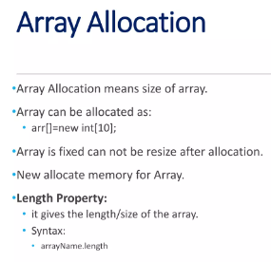

Slide 49
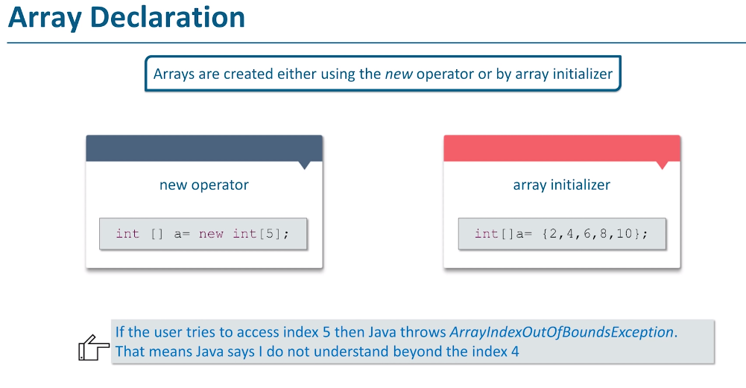

Slide 50
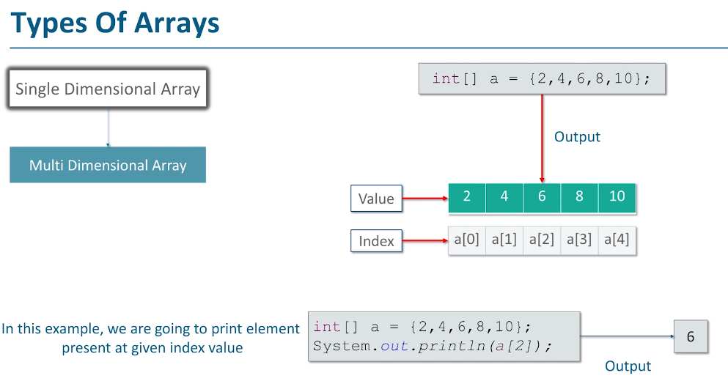

Slide 51
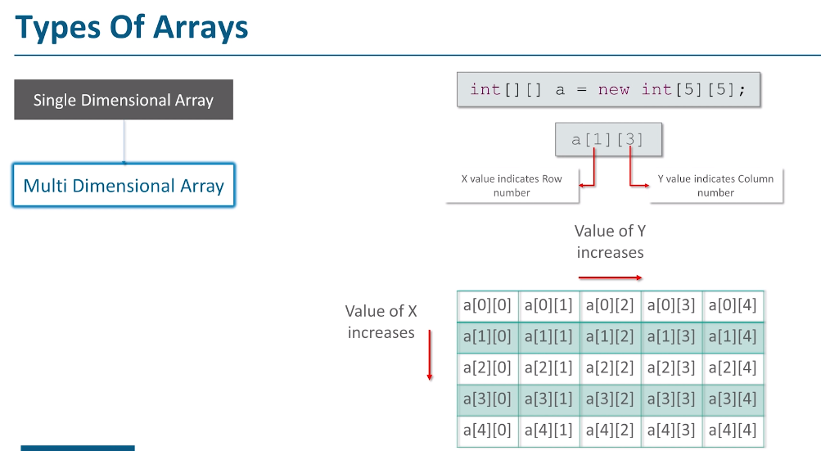

Slide 52
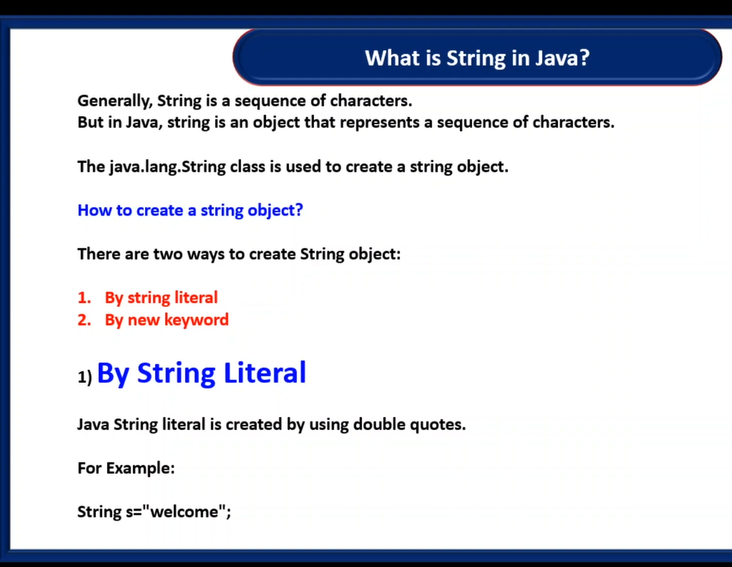

Slide 53
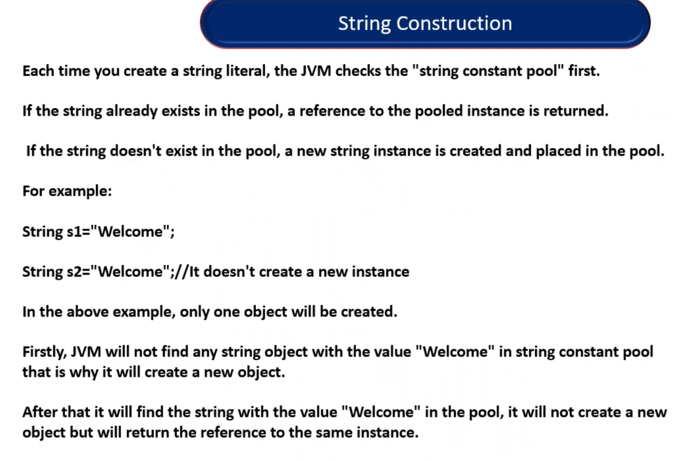

Slide 54
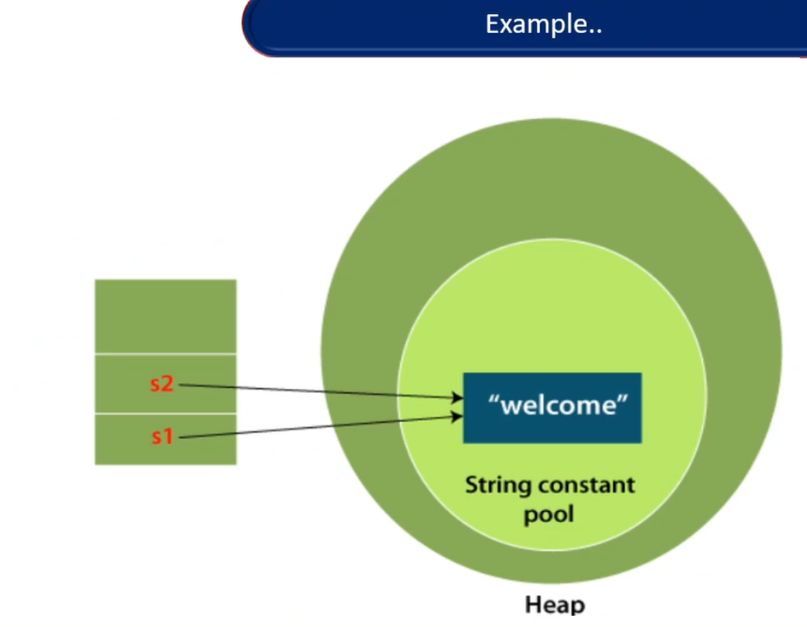

Slide 56


Slide 57


Slide 58


Slide 59


Slide 60


Slide 61


Slide 62


Slide 63


Slide 64
1. Classes and Objects
In Java, everything is an object. A class is a blueprint or a template for creating objects. An object is an instance of a class. It contains variables and methods that define its behavior.
2. Encapsulation
Encapsulation is the process of binding data and methods together into a single unit called a class. This provides a level of abstraction and makes it easy to manage and maintain code.
3.Abstraction
Abstraction is the process of hiding complex implementation details and showing only the essential features to the user. This can be achieved in Java through abstract classes and interfaces.

Slide 65
4.Inheritance
Inheritance is the ability of a class to inherit properties and methods from another class. The class that inherits from another class is called a subclass or a derived class. The class that is being inherited from is called the superclass or the base class.
5.Polymorphism
Polymorphism is the ability of an object to take on many forms. In Java, this can be achieved through method overloading and method overriding. Method overloading is when a class has multiple methods with the same name but different parameters. Method overriding is when a subclass provides its own implementation of a method that is already defined in the superclass.

Slide 66

Following image illustrates, as if car is a object what are it’s fields and methods

Slide 67

Realtime Example 1:
We are taking the example “person”. A person has three characteristics: Identity (name), State (properties), and behavior (actions or functionality). Look at the below figure.

Slide 68

Components of Class in Java

Slide 69


Slide 70

Access Modifiers in Java
Access modifiers are keywords in Java that are used to set accessibility. An access modifier restricts the access of a class, constructor, data member and method in another class.
Java language has four access modifier to control access level for classes and its members.
Default: Default has scope only inside the same package
Public: Public has scope that is visible everywhere
Protected: Protected has scope within the package and all sub classes
Private: Private has scope only within the classes
Java also supports many non-access modifiers,
such as static, abstract,
synchronized, native,
volatile, transient etc.

Slide 71


Slide 72


Slide 73


Slide 74


Slide 75


Slide 76


Slide 77


Slide 78


Slide 79


Slide 80


Slide 81


Slide 82



Slide 83


Slide 84

Polymorphism in Java, polymorphism is the OOPS concept that means one can perform a single action by various ways, actually poly means many and morph means forms, these both words are Greek words.
There are two types in polymorphism, one is compile time polymorphism and the second one is runtime polymorphism.
By using method overloading and method overriding developer can perform polymorphism.

Slide 85


Slide 86


Slide 87



Slide 88


Slide 89
Package in Java
A package is nothing but a physical folder structure (directories) that contains a group of related classes, interfaces, and sub-packages according to their functionality. It provides a convenient way to organize your work.
A real-life example is when you download a movie, song, or game, you make a different folder for each category like movie, song, etc. In the same way, a group of packages in java is just like a library.
The classes and interfaces of a package are like books in the library that can reuse several times when we need. This reusability nature of packages makes programming easy.

Slide 90


Slide 91

Predefined Packages in Java (Built-in Packages)
Predefined packages in java are those which are developed by Sun Microsystem.
They are also called built-in packages in java.

Slide 92

Naming Convention to declare User-defined Package in Real-time Project
While developing your project, you must follow some naming convention regarding packages declaration.

Slide 93


Slide 94
Abstract Class
A class which is declared using abstract keyword known as abstract class. An abstract class may or may not have abstract methods.
We cannot create object of abstract class.
It is used to achieve abstraction but it does not provide 100% abstraction because it can have concrete methods.
An abstract class must be declared with an abstract keyword.
It can have abstract and non-abstract methods.
It cannot be instantiated.
It is used for abstraction.

Slide 95

Non Access Modifiers in Java
They are abstract, final, static, strictfp, synchronized, transient, and volatile.

Slide 96

It can have only abstract methods and static fields. However, from Java 8, interface can have default and static methods

Slide 97

Advantages of Interface
It Support multiple inheritance
It helps to achieve abstraction
It can be used to achieve loose coupling.

Slide 98


Slide 100
What is Exception in Java?
An exception means a problem or an abnormal condition that stops a computer program from processing information in a normal way.
An exception in java is an object representing an error or an abnormal condition that occurs at runtime execution and interrupts (disrupts) the normal execution flow of the program.
An exception can be identified only at runtime, not at compile time. Therefore, it is also called runtime errors that are thrown as exceptions in Java.
They occur while a program is running.

Slide 101

1. Suppose you are watching a video on Youtube, suddenly, internet connectivity is disconnected or not working. In this case, you are not able to continue watching the video on Youtube.
This interruption is nothing but an exception.
2. Suppose a person is traveling by car from Mumbai to Pune. After traveling mid-distance, the tire of his car is punctured. This unexpected or unwanted event is nothing but an exception.

Slide 102

Types of Java Exceptions
There are mainly two types of exceptions: checked and unchecked. Here, an error is considered as the unchecked exception.
According to Oracle, there are three types of exceptions:
Checked Exception
Unchecked Exception
Error

Slide 103
1) Checked Exception
The classes which directly inherit Throwable class except RuntimeException and Error are known as checked exceptions e.g. IOException, SQLException etc.
Checked exceptions are checked at compile-time.
2) Unchecked Exception
The classes which inherit RuntimeException are known as unchecked exceptions e.g. ArithmeticException, NullPointerException, ArrayIndexOutOfBoundsException etc. Unchecked exceptions are not checked at compile-time, but they are checked at runtime.
3) Error
Error is irrecoverable e.g. OutOfMemoryError, VirtualMachineError, AssertionError etc.

Slide 104


Slide 105
Java provides five essential keywords to handle an exception. They are:
try
catch
finally
throw
Throws
These keywords can be used to handle exceptions properly.

Slide 106
Try Block in Java
A keyword “try” is a block of code or statements that might throw an exception. That’s why a try block is also known as exception generated block.
The three possible forms of try block are as follows:
try-catch: A try block is always followed by one or more catch blocks.
try-finally: A try block followed by a finally block.
try-catch-finally: A try block followed by one or more catch blocks followed by a finally block.

Slide 107
Catch Block in Java
A keyword “catch” is a block of code that handles the exception thrown by the try block. That’s why it is also known as exception handler block. A catch block that catches an exception, must be followed by try block that generates an exception.
The general syntax of try-catch block (exception handling block) is as follows:
Syntax:
try
{
// A block of code; // generates an exception
}
catch(exception_class var)
{
// Code to be executed when an exception is thrown.
}

Slide 108

The try-catch block is a technique used to catch and handle the exception. If an exception occurs in the try block, the rest of code in try block is not executed and the control of execution is transferred from the try block to catch block that handles exception thrown by try block.
A catch block acts as an exception handler that takes a single argument. This argument is a reference of an exception object that can be either the same class exception or superclass exception.

Slide 109

Rules of using Try and Catch block in Java
There are some rules for using try-catch block in java program.
They are as follows:
1. Java try-catch block must be within a method. 2. A try block can not be used without a catch or finally block. It must be followed by at least one catch block otherwise, the compilation error will occur. 3. A catch block must be followed by try block. There should not be any statement between the end of try block and the beginning of catch block. 4. A finally block cannot come before catch block.

Slide 110
Nested Try in Java
When a try block is defined within another try, it is called nested try block in java.
The try block which encloses another try block is called outer try block and the enclosed try block is called inner try block.
The syntax of nested try block is as follows: Syntax:
try // Outer try block
{
statements;
statements;
try // Inner try block
{
statements;
statements;
}
catch(Exception1 e1) // Inner catch block
{
statements;
statements;
}
}
catch(Exception2 e2) // Outer catch block
{
statements;
statements;
}

Slide 111
Finally Block in Java | A “finally” is a keyword used to create a block of code that follows a try or catch block.
A finally block contains all the crucial codes such as closing connections, stream, etc that is always executed whether an exception occurs within a try block or not.
When finally block is attached with a try-catch block, it is always executed whether the catch block has handled the exception thrown by try block or not.

Slide 112
Syntax for try-finally block:
try
{
statement1;
statement2;
}
finally // finally block
{
statement3;
}
Syntax for try-catch-finally block:
try
{
statement1;
statement2;
}
catch(Exceptiontype e1)
{
statement3;
}
statement4;
finally
{
statement5;
}

Slide 113
Custom Exceptions:
Java allows us to create our own exception class to provide own exception implementation. These type of exceptions are called user-defined exceptions or custom exceptions.
You can create your own exception simply by extending java Exception class.
class MyException extends Exception
{
private int ex;
MyException(int a)
{ ex = a; }
public String toString()
{ return "MyException[" + ex +"] is less than zero"; }
}
class Demo {
static void sum(int a,int b) throws MyException {
if(a<0) { throw new MyException(a); //calling constructor of user-defined exception class } else { System.out.println(a+b); } }
public static void main(String[] args)
{ try { sum(-10, 10); }
catch(MyException me)
{ System.out.println(me); //it calls the toString() method of user-defined Exception } } }

Slide 114
Points to Remember
Extend the Exception class to create your own exception class.
You don't have to implement anything inside it, no methods are required.
You can have a Constructor if you want.
You can override the toString() function, to display customized message.

Slide 115
Java Throw
The throw keyword is used to throw an exception explicitly. Only object of Throwable class or its sub classes can be thrown. Program execution stops on encountering throw statement, and the closest catch statement is checked for matching type of exception.
Syntax :
class Test { static void avg()
{ try { throw new ArithmeticException("demo"); }
catch(ArithmeticException e) { System.out.println("Exception caught"); } }
public static void main(String args[])
{ avg();
}
}
Java throws Keyword
The throws keyword is used to declare the list of exception that a method may throw during execution of program. Any method that is capable of causing exceptions must list all the exceptions possible during its execution, so that anyone calling that method gets a prior knowledge about which exceptions are to be handled. A method can do so by using the throws keyword.

Slide 116
Here, we have a method that can throw Arithmetic exception so we mentioned that with the method declaration and catch that using the catch handler in the main method.
class Test
{ static void check() throws ArithmeticException
{
System.out.println("Inside check function"); throw new ArithmeticException("demo"); } public static void main(String args[])
{ try { check(); } catch(ArithmeticException e)
{ System.out.println("caught" + e); } } }

Slide 117
Difference between throw and throws
throw | throws
throw keyword is used to throw an exception explicitly. | throws keyword is used to declare an exception possible during its execution.
throw keyword is followed by an instance of Throwable class or one of its sub-classes. | throws keyword is followed by one or more Exception class names separated by commas.
throw keyword is declared inside a method body. | throws keyword is used with method signature (method declaration).
We cannot throw multiple exceptions using throw keyword. | We can declare multiple exceptions (separated by commas) using throws keyword.

Slide 118


Slide 119
What is Collection in Java
A collection is a group of objects. In Java, these objects are called elements of the collection.
The Java Collections Framework is a collection of interfaces and classes which helps in storing and processing the data efficiently.
You can perform all operations such as searching, sorting, insertion, manipulation, deletion, etc., on Java collections just like you do it on data.
A Java collection framework includes the following:
Interfaces
Classes
Algorithm

Slide 120
Interfaces: Interface in Java refers to the abstract data types. They allow Java collections to be manipulated independently from the details of their representation. Also, they form a hierarchy in object-oriented programming languages.
Classes: Classes in Java are the implementation of the collection interface. It basically refers to the data structures that are used again and again.
Algorithm: Algorithm refers to the methods which are used to perform operations such as searching and sorting, on objects that implement collection interfaces. Algorithms are polymorphic in nature as the same method can be used to take many forms or you can say perform different implementations of the Java collection interface.

Slide 121
Why use Java collection?
There are several benefits of using Java collections such as:
Reducing the effort required to write the code by providing useful data structures and algorithms
Java collections provide high-performance and high-quality data structures and algorithms thereby increasing the speed and quality
Unrelated APIs can pass collection interfaces back and forth
Decreases extra effort required to learn, use, and design new API’s
Supports reusability of standard data structures and algorithms

Slide 122

Java Collection Framework Hierarchy

Slide 123
Collection Interface in Java
The basic interface of the collections framework is the Collection interface which is the root interface of all collections in the API (Application programming interface). It is placed at the top of the collection hierarchy in java. It provides the basic operations for adding and removing elements in the collection.
The Collection interface extends the Iterable interface. The iterable interface has only one method called iterator(). The function of the iterator method is to return the iterator object. Using this iterator object, we can iterate over the elements of the collection.
List, Queue, and Set have three component which extends the Collection interface. A map is not inherited by Collection interface.

Slide 124
List Interface
➲ This interface represents a collection of elements whose elements are arranged sequentially ordered.
➲ List maintains an order of elements means the order is retained in which we add elements, and the same sequence we will get while retrieving elements.
➲ We can insert elements into the list at any location. The list allows storing duplicate elements in Java.
➲ ArrayList, vector, and LinkedList are three concrete subclasses that implement the list interface.

Slide 125
Set Interface
➲ This interface represents a collection of elements that contains unique elements. i.e, It is used to store the collection of unique elements.
➲ Set interface does not maintain any order while storing elements and while retrieving, we may not get the same order as we put elements. All the elements in a set can be in any order.
➲ Set does not allow any duplicate elements.
➲ HashSet, LinkedHashSet, TreeSet classes implements the set interface and sorted interface extends a set interface.
➲ It can be iterated by using Iterator but cannot be iterated using ListIterator.

Slide 126
SortedSet Interface
➲ This interface extends a set whose iterator transverse its elements according to their natural ordering.
➲ TreeSet implements the sorted interface.
Queue Interface
➲ A queue is an ordered of the homogeneous group of elements in which new elements are added at one end(rear) and elements are removed from the other end(front). Just like a queue in a supermarket or any shop.
➲This interface represents a special type of list whose elements are removed only from the head.
➲ LinkedList, Priority queue, ArrayQueue, Priority Blocking Queue, and Linked Blocking Queue are the concrete subclasses that implements the queue interface.

Slide 127

Deque Interface
➲ A deque (double-ended queue) is a sub-interface of queue interface. It is usually pronounced “deck”.
➲ This interface was added to the collection framework in Java SE 6.
➲ Deque interface extends the queue interface and uses its method to implement deque.
The hierarchy of the deque interface is shown in the below figure.

Slide 128
➲ It is a linear collection of elements in which elements can be inserted and removed from either end. i.e, it supports insertion and removal at both ends of an object of a class that implements it.
➲ LinkedList and ArrayDeque classes implement the Deque interface.

Slide 129

Map Interface
➲ Map interface is not inherited by the collection interface. It represents an object that stores and retrieves elements in the form of a Key/Value pairs and their location within the Map are determined by a Key.
The hierarchy of the map interface is shown in the below figure.
➲ Map uses a hashing technique for storing key-value pairs.
➲ It doesn’t allow to store the duplicate keys but duplicate values are allowed.
➲ HashMap, HashTable, LinkedHashMap, TreeMap classes implements Map interface.
SortedMap Interface
➲ This interface represents a Map whose elements are stored in their natural ordering. It extends the Map interface which in turn is implemented by TreeMap classes.

Slide 130
List in Java
➲ A list in Java is a collection for storing elements in sequential order. Sequential order means the first element, followed by the second element, followed by the third element, and so on.
A good realtime example of list is a line of train bogies on a track: To get to the fourth bogie from the first bogie, we have to go through the second and third bogies in that order.
➲ Java list is a sub-interface of the collection interface that is available in java.util package. Sub interface means an interface that extends another interface is called sub interface. Here, the list interface extends the collection interface.
The general declaration of list interface in java is as follows:
public interface List<E> extends Collection<E>

Slide 131
➲ It is an ordered collection where elements are maintained by index positions because it uses an index-based structure. In the list interface, the order is retained in which we add elements. We will also get the same sequence while retrieving elements.
➲ It is used to store a collection of elements where duplicate elements are allowed.
➲ List interface in java has four concrete subclasses. They are ArrayList, LinkedList, Vector, and Stack. These four subclasses implements the list interface. ArrayList and LinkedList are widely used in Java program to create a list.

Slide 132
Features of List Interface in Java
There are the following features of list in java. They are as follows:
1. The list allows storing duplicate elements in Java. JVM differentiate duplicate elements by using ‘index’. Index refers to the position of a certain object in an array. It always starts at zero.
For example, assume that there is a list with size 10. Suppose the first element is ‘a’ at zero index position and the second element is also ‘a’ which is at 9th position. Thus, there are two ‘a’ elements in the list at position 0 and 9 respectively.
So, JVM will differentiate between both elements in the list based on their numeral position of the index. Therefore, the index is very useful and plays an important role to differentiate objects.
2. In the list, we can add an element at any position.
3. It maintains insertion order. i.e. List can preserve the insertion order by using the index.
4. It allows for storing many null elements.

Slide 133
5. Java list uses a resizable array for its implementation. Resizable means we can increase or decrease the size of the array.
6. Except for LinkedList, ArrayList, and Vector is an indexed based structure.
7. It provides a special Iterator called a ListIterator that allows accessing the elements in the forward direction using hasNext() and next() methods.
In the reverse direction, it access elements using hasPrevious() and previous() methods.
We can add, remove elements of the collection, and can also replace the existing elements with the new element using ListIterator.

Slide 134
When to use List?
There are the following points for using list in java application that should be to keep in mind. They are:
1. List can be used when we want to allow or store duplicate elements.
2. It can be used when we want to store null elements.
3. When we want to preserve my insertion order, we should go for list.

Slide 135
ArrayList in Java
➲ ArrayList in Java is a resizable-array that can grow or shrink in the memory whenever needed. It is dynamically created with an initial capacity.
It means that if the initial capacity of the array is exceeded, a new array with larger capacity is created automatically and all the elements from the current array are copied to the new array.
➲ Elements in ArrayList are placed according to the zero-based index. That is the first element will be placed at 0 index and the last element at index (n-1) where n is the size of ArrayList.
➲ Java ArrayList uses a dynamic array internally for storing the group of elements or data.
➲ The capacity of ArrayList does not shrink automatically. When elements are removed from the list, the size of array list can be shrunk automatically but not capacity.

Slide 136
Serializable Interface
1. A serializable interface is a marker interface that is used to send the group of objects over the network. It is present in the java.io package.
2. It helps in sending the data from one class to another class. Usually, we use collections to hold and transfer objects from one place to another place. To provide support for this requirement, every collections class already implements Serializable and Cloneable.
Cloneable Interface
1. A cloneable interface is present in java.lang package.
2. It is used to create exactly duplicate objects. When the data or group of objects came from the network, the receiver will create duplicate objects. The process of creating exactly duplicate objects is known as cloning. It is a very common requirement for collection classes.

Slide 137
Features of ArrayList in Java
There are several features of ArrayList class in Java. They are as follows:
1. Resizable-array: ArrayList is a resizable array or growable array that means the size of ArrayList can increase or decrease in size at runtime. Once ArrayList is created, we can add any number of elements.
2. Index-based structure: It uses an index-based structure in java.
3. Duplicate elements: Duplicate elements are allowed in the array list.
4. Null elements: Any number of null elements can be added to ArrayList.
5. Insertion order: It maintains the insertion order in Java. That is insertion order is preserved.
6. Heterogeneous objects: Heterogeneous objects are allowed everywhere except TreeSet and TreeMap. Heterogeneous means different elements.
7. Synchronized: ArrayList is not synchronized. That means multiple threads can use the same ArrayList objects simultaneously.
8. Random Access: ArrayList implements random access because it uses an index-based structure. Therefore, we can get, set, insert, and remove elements of the array list from any arbitrary position.
9. Performance: In ArrayList, manipulation is slow because if any element is removed from ArrayList, a lot of shifting takes place. For example, if an array list has 500 elements and we remove 50th elements then the 51st element will try to acquire that 50th position, and likewise all elements. Thus, it consumes a lot of time shifting.

Slide 138
When to use ArrayList in Java?
ArrayList can be used in an application program when
We want to store duplicate elements.
We want to store null elements.
It is more preferred in Java when getting of the element is more as compared to adding and removing elements.
We are not working in the multi-threading environment in Java because ArrayList is non-synchronized.

Slide 139

Iterators in Java
Iterators in Java are used to retrieve the elements one by one from a collection object. They are also called cursors in java.
Types of Iterators in Java
There are four types of iterators or cursors available in Java. They are as follows:
Enumeration
Iterator
ListIterator
Spilterator

Slide 140
Enumeration in Java
It is a legacy interface that is implemented to get elements one by one from the legacy collection classes such as Vector and Properties.
Methods of Enumeration in Java
The Enumeration interface defines the following two methods. They are as follows:
1. public boolean hasMoreElements(): When this method is implemented, hasMoreElements() will return true If there are still more elements to extract and false if all the elements have been enumerated.
2. public Object nextElement(): The nextElement() method returns next element in the enumeration. It will throw NoSuchElementException when the enumeration is complete.

Slide 141
Limitation of Enumeration
There are many limitations of using enumeration interface in java. They are as follows:
1. Enumeration concept is applicable for only legacy class. Hence, it is not a universal cursor.
2. We can get only read operation by using the enumeration. We cannot perform remove operation.
3. We can iterate using enumeration only in the forward direction.
4. Java is not recommended to use it in new projects.
Iterator in Java
An iterator in Java is a special type of object that provides sequential (one by one) access to the elements of a collection object.

Slide 142
Difference between Enumeration and Iterator
Both are useful to retrieve elements from a collection. But the main difference between
Enumeration and iterator is with respect to functionality.
By using an enumeration, we can perform only read access but using an iterator,
we can perform both read and remove operation.
Advantage of Iterator in Java
Java Iterator has the following advantages. They are as follows:
An iterator can be used with any collection classes.
We can perform both read and remove operations.
It acts as a universal cursor for collection API.
Limitation of Iterator in Java
Iterator has the following limitations or drawbacks. They are as:
1. By using Enumeration and Iterator, we can move only towards forwarding direction.
We cannot move to the backward direction. Hence, these are called single direction cursors. 2. We can perform either read operation or remove operation. 3. We cannot perform the replacement of new objects.

Slide 143
Java Collections : Interface
Iterator interface : Iterator is an interface that iterates the elements. It is used to traverse the list and modify the elements. Iterator interface has three methods which are mentioned below:
public boolean hasNext() – This method returns true if the iterator has more elements.
public object next() – It returns the element and moves the cursor pointer to the next element.
public void remove() – This method removes the last elements returned by the iterator.
Java collections: List
A List is an ordered Collection of elements which may contain duplicates. It is an interface that extends the Collection interface. Lists are further classified into the following:
ArrayList
LinkedList
Vectors

Slide 144
Array list: ArrayList is the implementation of List Interface where the elements can be dynamically added or removed from the list.

Slide 145

Linked List: Linked List is a sequence of links which contains items. Each link contains a connection to another link.
Syntax: Linkedlist object = new Linkedlist();
Java Linked List class uses two types of Linked list to store the elements:
Singly Linked List
Doubly Linked List
Singly Linked List: In a singly Linked list each node in this list stores the data of the node and a pointer or reference to the next node in the list. Refer to the below image to get a better understanding of single Linked list.

Slide 146

Doubly Linked List: In a doubly Linked list, it has two references, one to the next node and another to previous node. You can refer to the below image to get a better understanding of doubly linked list.

Slide 147
Vectors : Vectors are similar to arrays, where the elements of the vector object can be accessed via an index into the vector. Vector implements a dynamic array. Also, the vector is not limited to a specific size, it can shrink or grow automatically whenever required.
It is similar to ArrayList, but with two differences :
Vector is synchronized.
Vector contains many legacy methods that are not part of the collections framework.

Slide 148

Java Collections: Sets
A Set refers to a collection that cannot contain duplicate elements. It is mainly used to model the mathematical set abstraction. Set has its implementation in various classes such as HashSet, TreeSetand LinkedHashSet.

Slide 149
HashSet: Java HashSet class creates a collection that use a hash table for storage. Hashset only contain unique elements and it inherits the AbstractSet class and implements Set interface. Also, it uses a mechanism hashing to store the elements.

Slide 150



Slide 151
Multithreading

Slide 152

What is Thread in Java
A thread in Java simply represents a single independent path of execution of a group of statements. It is the flow of execution, from beginning to end, of a task.
When we write a group of statements in a program, these statements are executed by JVM one by one. This execution process is called thread in Java.
There is always at least one thread running internally in every program and this thread is used by JVM to execute statements in the program.
When a program contains a single flow of control, it is called single-threaded program. In a single thread program, there is a beginning, a body, and an end, and execute commands sequentially. Look at the below figure.

Slide 153
We can also create more than one execution thread in a program that can be used to perform multiple tasks simultaneously.
When we create more than one thread in a program, each thread has its own path of execution and all the threads share the same memory address space, data, and code in a program.
What is Process in Java?
Thread in Java is the smallest unit of executable code in a program. It helps to divide a program into multiple parts to speed up the process. A process is a program that executes as a single thread. In other words, when an executable program is loaded into memory, it is called process.
Points to be Noted:
1. Every individual process has its own separate memory address space and can execute a different program.
2. Each process can have more than one thread.
3. Each process communicates through the operating system, files, and network.
When we will create a new thread in a program, it shares the same memory address space with other threads in a program whereas every individual process has its own separate memory address space.

Slide 154

Therefore, creating a thread takes fewer resources than creating a new process. Look at the below figure to understand better.
As you can see in the above figure, the thread is executed inside a process and one process can have also multiple threads. There can be multiple processes inside the operating system.
Multiple Threads are independent of each other. At a time only one thread is executed. If an exception occurs in one thread, it doesn’t affect other threads.

Slide 155

What is Multithreading in Java
Multithreading means multiple threads of execution concurrently. The process of executing multiple threads simultaneously (concurrently) is called multithreading in Java.
In other words, multithreading is a technique or programming concept in which a program (process) is divided into two or more subprograms (subprocesses), each of which can perform different tasks simultaneously (at the same time and in parallel manner). Each subprogram of a program is called thread in Java.
Look at the below figure where a Java program has three threads, one main and two others. The other two threads ThreadA and ThreadB are created and started from the main thread. When a program contains multiple flows of control, it is called multithreaded program.

Slide 156
Once initiated by the main thread, thread ThreadA and ThreadB run simultaneously and share the resources together. It is the same as people living in a joint family and sharing certain resources among all of them.
When a program contains more than one thread, the CPU can switch between two threads to execute them at the same time. The switching between two threads is known as context switch. The switching from one thread to another thread occurs so fast that it appears to the users that all threads are being executed at the same time. But in reality, only one thread is executed at a time.
This technique is useful for those applications which need multiple tasks to be done simultaneously. In a single processor system, multiple threads share CPU time that is known as time-sharing.

Slide 157
The operating system is responsible for allocating and scheduling resources to them. Thus, multithreading improves the performance of CPU by maximum utilization and keeping the idle time of CPU to minimum.
In a multithreaded program, each thread is assigned a single task to perform and executes independently. If an exception occurs in one thread, it does not affect other threads during the execution.
For example, one thread read data, another thread process it, and third thread write it, thus improves the overall performance of an application.
We can write a multithreaded program to display animations, to play music, and download a file from the network at the same time.

Slide 158
Use of Thread in Java
Threads can be used for multiple purposes. Some advantages of using threads are as follows:
1. Threads are mainly used in server-side programs where we need to handle multiple clients on network or internet simultaneously.
2. Another important use of threads is in creating games and animations. For example, threads can be used to show picture in motion. In many games, threads help to perform more than one task simultaneously.
For example, in fighter game, a fighter plane may be from left to right. A machine gun in fighter plane continuously shoots enemy by releasing bullets.
Here, two tasks are happening simultaneously. One thread is moving the fighter plane while another thread releasing bullets simultaneously.
3. Generally, threads can be used to perform more than one task simultaneously.
A program running on a single thread can cause problems when we want to perform two or more tasks simultaneously. For example, when you play online cricket game, you sometimes see such a situation where game does not show the updated score but still displays graphics properly.
Here, displaying graphics of game and updating scores are two different jobs that are to be handled at the same time. Therefore, it is important that the game programming must be able to handle these multiple tasks to make game fast.
To overcome these problems, Java supports multithreaded programming that enables a single program to perform multiple tasks simultaneously.

Slide 159
Advantage of Multithreading in Java
The advantages of using multithreading programming concept are as follows:
1. In a multithreaded application program, different parts of the application are executed by different threads. The entire application does not stop even if an exception occurs in any of the threads. It does not affect other threads during the execution of the application.
2. Different threads are allotted to different processors and each thread is executed in different processors in parallel.
3. Multithreading helps to reduce computation time.
4. Multithreading technique improves the performance of the application.
5. Threads share the same memory address space. Hence, it saves memory.
6. Multithreaded program makes maximum utilization of CPU and keeping the idle time of CPU to minimum.
7. Context switching from one thread to another thread is less expensive than between processes.

Slide 160
Drawbacks of Multithreading in Java
The drawbacks of multithreading are as follows:
1. Increased complexity.
2. Synchronization of shared resources.
3. In the multithreading programming concept, debugging is difficult. At times, result is unpredictable.
4. Potential deadlocks.
5. Programming complications may occur.

Slide 161
Multitasking in Java
The process of executing one or more tasks concurrently or at the same time is called multitasking. It is the ability of an operating system to execute multiple tasks at once. The main purpose of multitasking is to use the idle time of CPU.
Multitasking can be implemented in two ways: 1. Process-based multitasking (Multiprocessing) 2. Thread-based multitasking (Multithreading)
Process-based Multitasking (Multiprocessing)
The process of executing multiple programs or processes at the same time (concurrently) is called process-based multitasking or program-based multitasking. In process-based multitasking, several programs are executed at the same time by the microprocessor.
Therefore, it is also called multiprocessing in Java. It is a heavyweight. A process-based multitasking feature allows to execute two or more programs concurrently on the computer.
A good example is, running spreadsheet program while also working with word-processor.
Each program (process) has its own address space in the memory. In other words, each program is allocated in a separate memory area.

Slide 162
The operating system requires some CPU time to switch from one program to another program. The switching of CPU among programs is called context switching.
The switching from one program to another program is so fast that it appears to the user that multiple tasks are being done at the same time.
Thread-based Multitasking (Multithreading)
A thread is a separate path of execution of code for each task within a program. In thread-based multitasking, a program uses multiple threads to perform one or more tasks at the same time by a processor.
That is, thread-based multitasking feature allows you to execute several parts of the same program at once. Each thread has a different path of execution.

Slide 163

Realtime Example of Multithreading in Java
Let’s take different examples of thread-based multithreading in Java.
1. A very good example of thread-based multithreading is a word processing program that checks the spelling of words in a document while writing the document. This is possible only if each action is performed by a separate thread.
2. Another familiar example is a browser that starts rendering a web page while it is still downloading the rest of page.
Consider a program as shown in the below figure. The program is divided into two parts. These parts may represent two separate blocks of code or two separate methods that can perform two different tasks of the same program.

Slide 164
Hence, a processor will create two separate threads to execute these two parts simultaneously. Each thread acts as an individual process that will execute a separate block of code.
Thus, a processor has two threads that will perform two different tasks at a time. This multitasking is called thread-based multiple tasking.
Advantage of Thread-based Multitasking over Process-Thread Multitasking
The main advantages of thread-based multitasking as compared to process-based tasking are
1. Threads share the same memory address space. 2. Context switching from one thread to another thread is less expensive than between processes. 3. The cost of communication between threads is relatively low.
4. Threads are lightweight as compared to processes (heavyweight). They utilize the minimum resources of the system. They take less memory and less processor time.
Java supports thread-based multitasking and provides a high quality of facilities for multithreading programming.
A great way to remember the difference between process-based multitasking and thread-based multitasking is process-based multitasking works with multiple programs or processes whereas thread-based multitasking works with parts of one program.

Slide 165

Creating threads in Java | We know that every Java program has at least one thread called main thread. When a program starts, main thread starts running immediately.
Apart from this main thread, we can also create our own threads in a program that is called child thread.
Every child threads create from its main thread known as parent thread.

Slide 166
Extending Thread Class in Java
Extending Thread class is the easiest way to create a new thread in Java. The following steps can be followed to create your own thread in Java.
Class Myclass extends Thread
Now in this newly created class, define a method run(). Here, run() method acts as entry point of the new thread. The run() method contains the actual task that thread will perform. Thus, we override run() method of Thread class.
public void run()
{
// statements to be executed.
}

Slide 167
Life Cycle of Thread in Java
Life Cycle of Thread in Java is basically state transitions of a thread that starts from its birth and ends on its death.
When an instance of a thread is created and is executed by calling start() method of Thread class, the thread goes into runnable state. When sleep() or wait() method is called by Thread class, the thread enters into non-runnable state.
From non-runnable state, thread comes back to runnable state and continues execution of statements. When the thread comes out of run() method, it dies.
These state transitions of a thread are called Thread life cycle in Java.

Slide 168

Thread States in Java
A thread is a path of execution in a program that enters in any one of the following five states during its life cycle.
The five states are as follows:
1. New
2. Runnable
3. Running
4. Blocked (Non-runnable state)
5. Dead

Slide 169

New (Newborn State): When we create a thread object using Thread class, thread is born and is known to be in Newborn state. That is, when a thread is born, it enters into new state but the start() method has not been called yet on the instance.

Slide 170
In other words, Thread object exists but it cannot execute any statement because it is not an execution of thread. Only start() method can be called on a new thread; otherwise, an IllegalThreadStateException will be thrown.
2. Runnable state: Runnable state means a thread is ready for execution. When the start() method is called on a new thread, thread enters into a runnable state.
In runnable state, thread is ready for execution and is waiting for availability of the processor (CPU time). That is, thread has joined queue (line) of threads that are waiting for execution.
3.Running state: Running means Processor (CPU) has allocated time slot to thread for its execution. When thread scheduler selects a thread from the runnable state for execution, it goes into running state. Look at the above figure.
In running state, processor gives its time to the thread for execution and executes its run method. This is the state where thread performs its actual functions. A thread can come into running state only from runnable state.

Slide 171


Slide 172
1. When sleep() method is invoked on a thread to sleep for specified time period, the thread is out of queue during this time period. The thread again reenters into the runnable state as soon as this time period is elapsed.
2. When a thread is suspended using suspend() method for some time in order to satisfy some conditions. A suspended thread can be revived by using resume() method.
3. When wait() method is called on a thread to wait for some time. The thread in wait state can be run again using notify() or notifyAll() method.
4. Blocked state: A thread is considered to be in the blocked state when it is suspended, sleeping, or waiting for some time in order to satisfy some condition.
5. Dead state: A thread dies or moves into dead state automatically when its run() method completes the execution of statements. That is, a thread is terminated or dead when a thread comes out of run() method. A thread can also be dead when the stop() method is called.

Slide 173


Slide 174


Slide 175


Slide 176


Slide 177


